Slide 1
Code for India
Lets Code to make our life better
Code for a better government

Slide 2
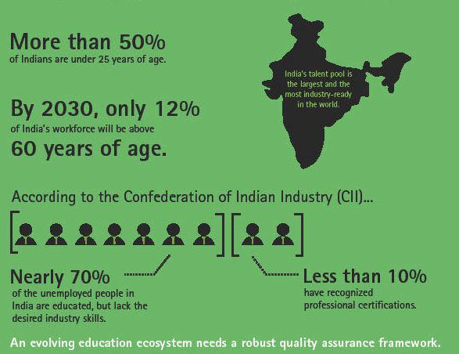
NGO

Slide 3
Indian Government’s initiative
Success is almost synonymous with IT knowledge.
Government is willing to spend on IT..
Sakshat
They are willing to pay Rs.7000/pm to workers.
Spreading digital literacy for teachers empowerment (100 Cr project)
http://www.sakshat.ac.in/PDF/NewLink.htm
Spoken tutorials project
NPTEL
Aakash tablets

Slide 4
Mandate – Spread IT
Three potential subjects
College students
Arts, Commerce, Law
Basic IT skills like MS Office, Paint, Linux
Villagers
Very basic IT like reviews, train ticket, blogs, whether forecast.
Government – our current focus
Improve IT interfaces of government
Citizen partnership by making it free and open source(FOSS).

Slide 5
Feasibility
Teach for America
Teach for India
Code for America
Code for India
Notes:
http://codeforamerica.org/2012/03/08/jennifer-pahlka-at-ted-video/
http://codeforamerica.org/donors/

Slide 6

Teach for America

Slide 7

Teach for India

Slide 8
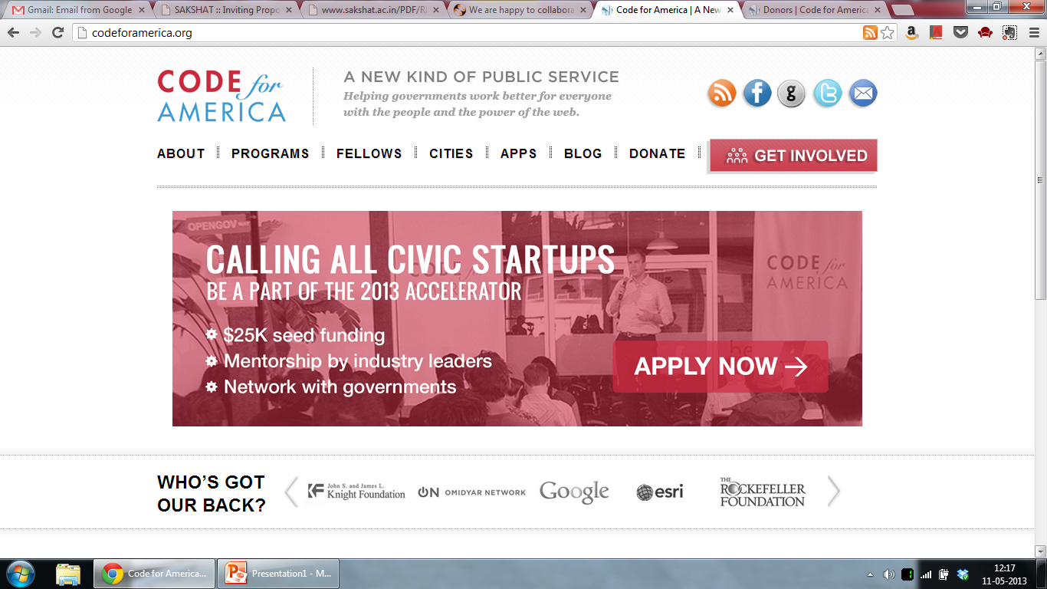
Code for America

Slide 9
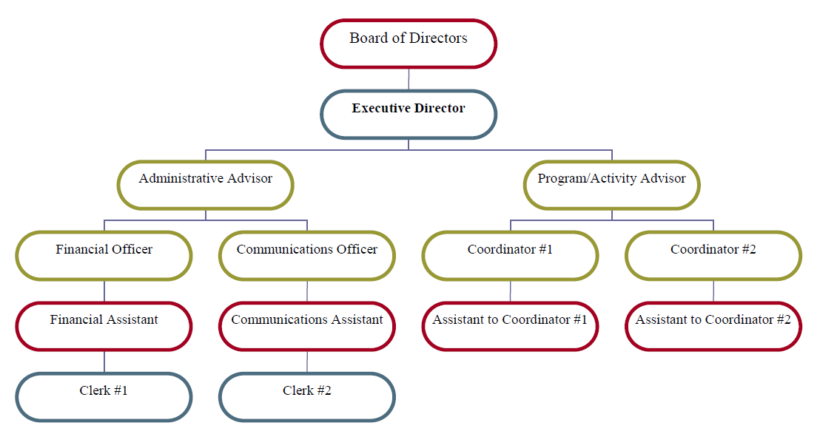
Code of India

Slide 10
Project - X
Website for all non-IT colleges
Current Features
Single unified standard backend
Adding/removing Faculty/ Courses.
Editing content.
Adding/Deleting news.
Videos (screencasts) for help.
Update functionality
Online admissions
Proposed features
Customizable Frontend
Plugins

Slide 11
User interface

